Slide 1
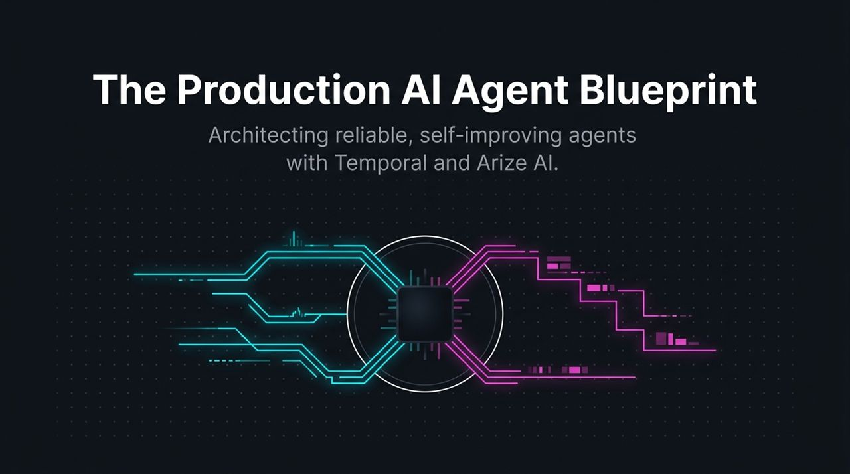
Notes:
Hello everyone, and welcome. Today, we’re presenting the Production AI Agent Blueprint—a complete framework for taking AI agents out of the experimental demo stage and deploying them safely into production.
Right now, AI development is moving at breakneck speed. Building a prototype agent in a Jupyter notebook or a lightweight script is remarkably fast. But as soon as you try to ship that agent into a real production environment where users rely on it for critical workflows—like processing purchases, executing long-running research, or coordinating multi-step transactions—everything changes.
In production, you run into two major brick walls:
Infrastructure Chaos: Network blips, third-party API timeouts (like Stripe or OpenAI dropping connections), server restarts, and container deaths mid-task.
Model Chaos: LLMs hallucinating non-existent items, making improper tool choices, losing context, or looping endlessly.
To solve both halves of this problem, you need a dual architecture. Temporal provides the Durable Execution layer that keeps your code running to completion no matter what crashes beneath it. Arize AI provides the AI Observability and Evaluation layer that shows you exactly what happened inside the model’s reasoning path and automatically evaluates its quality.
By the end of this deck, you’ll understand how these two systems integrate into a seamless continuous improvement loop.
How to Build Reliable Long-Running AI Agents | Temporal + Arize
https://www.youtube.com/watch?v=TAXglqzS7F0

Slide 2
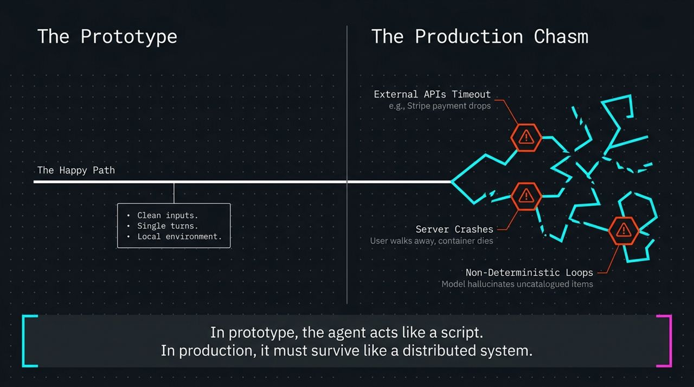
Notes:
Let's talk about why so many AI agent projects get stuck in 'prototype purgatory'.
Look at the diagram on the left. In a prototype, you build for the Happy Path. You have clean inputs, single-turn interactions, static mocks, and you test locally where containers never die and APIs always return 200 OK. In this stage, the agent behaves like a simple, linear script.
But look at what happens on the right when you deploy that same script into Production:
External API Timeouts: You call an external service—say, Stripe for a payment or a web search tool. The API drops the connection or takes 45 seconds to respond. Your HTTP client times out, and your entire script throws an unhandled exception.
Server & Container Crashes: Your agent might be running a multi-step research job that takes 20 minutes or hours. Halfway through step 4, the user navigates away or Kubernetes kills the worker node due to an Out-Of-Memory (OOM) error. Everything in memory is wiped out.
Non-Deterministic Loops: The model decides to search for a product, gets an ambiguous response, calls the tool again, hallucinates an uncatalogued item ID, and enters an infinite tool-calling loop that burns thousands of tokens.
Key Takeaway: In a prototype, an AI agent acts like a script. In production, it must survive like a distributed system. You cannot build a reliable production agent simply by wrapping try/except blocks around an LLM call.

Slide 3
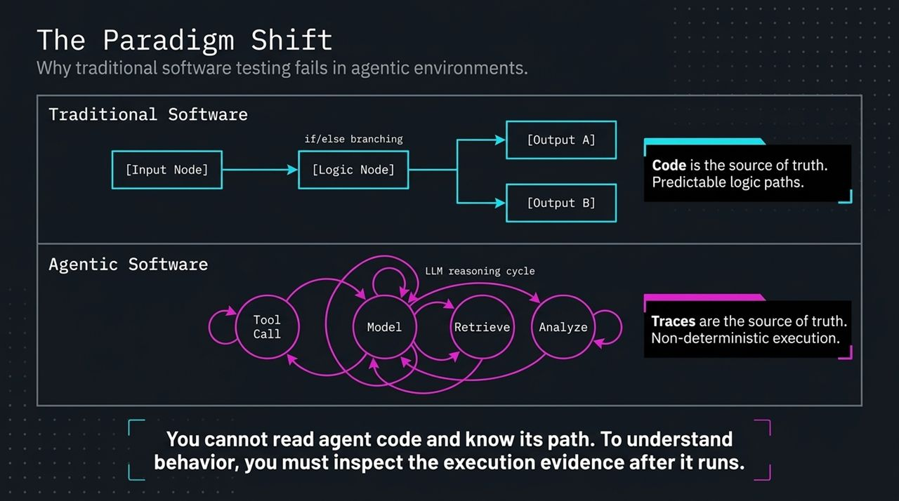
Notes:
Why can’t we just use standard software testing and monitoring tools to maintain AI agents? Because agentic software represents a fundamental paradigm shift in software engineering.
In Traditional Software, you write explicit code logic—if/else branching, static routing, predictable paths. Code is the source of truth. If a user provides Input Node X, you can trace the code statically and know with 100% certainty whether it will hit Output A or Output B. You write unit tests that assert deterministic outputs.
In Agentic Software, you hand control over to an LLM reasoning cycle. The model dynamically decides whether to call a tool, retrieve vector context, analyze data, or loop back to re-evaluate.
This means execution is non-deterministic. You can pass the exact same user prompt three times in a row, and the model might take three completely different execution paths to reach an answer!
Because of this, you cannot read agent code and know its execution path. Traces are the true source of truth. To understand how your agent behaved, why it made a mistake, or which tool failed, you must inspect the execution evidence captured after the run completes.

Slide 4
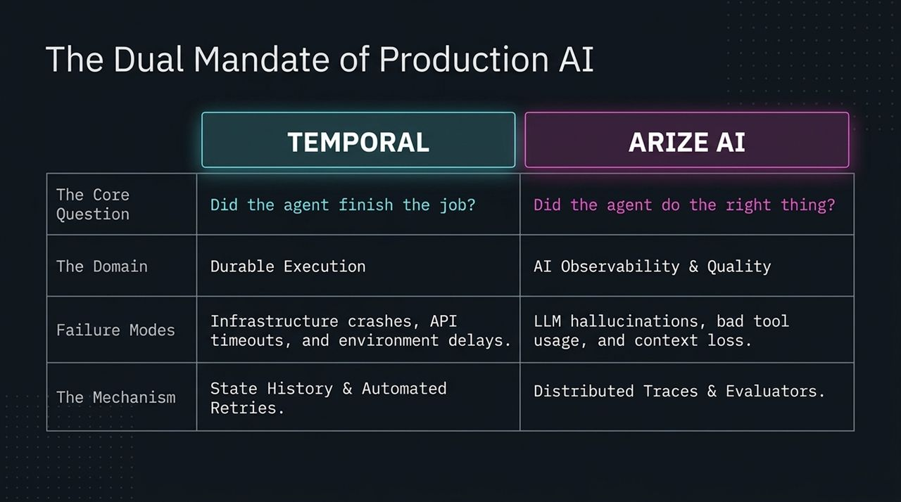
Notes:
To run AI agents reliably at scale, production systems must fulfill two distinct mandates, answered by two core engineering questions:
Mandate 1: Did the agent finish the job?
Domain: Durable Execution, handled by Temporal.
Failure Modes Addressed: Infrastructure crashes, network glitches, API rate-limits, container evictions, and long delays waiting for asynchronous events.
Mechanism: Temporal maintains persistent state history and automated retries. It guarantees that no matter what happens to your underlying compute nodes, your agent’s workflow runs to completion.
Mandate 2: Did the agent do the right thing?
Domain: AI Observability and Quality, handled by Arize AI.
Failure Modes Addressed: LLM hallucinations, wrong tool routing, ignoring retrieved context, generating harmful content, or losing multi-turn conversation context.
Mechanism: Arize uses distributed OpenTelemetry/OpenInference traces and automated LLM-as-a-Judge evaluators.
If your agent finishes its job but outputs hallucinated nonsense, you fail. Conversely, if your agent has perfect prompt logic but dies during a server migration, you also fail. You need both systems working in harmony.

Slide 5
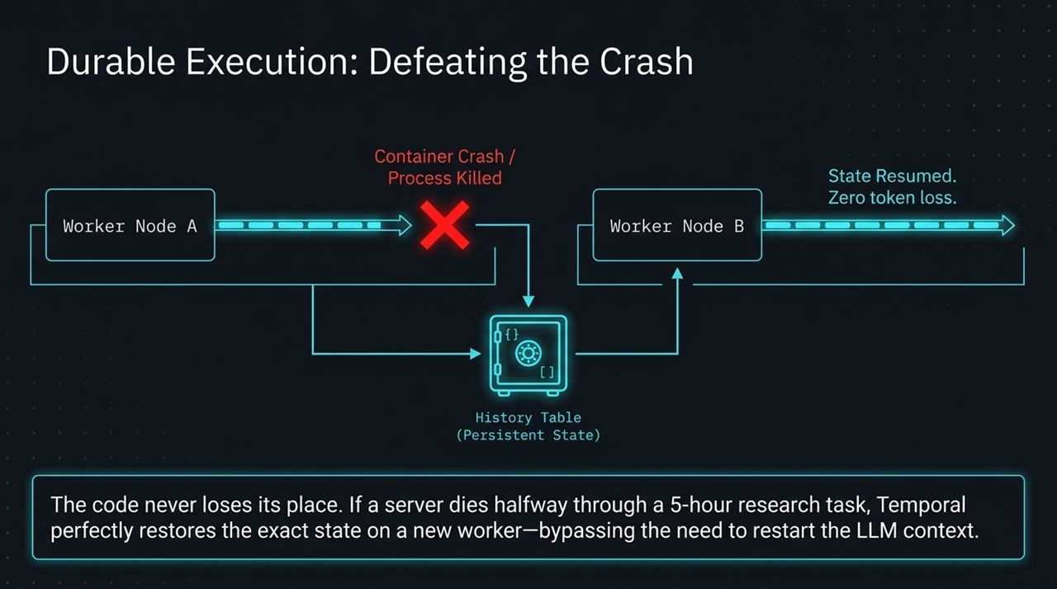
Notes:
Let’s dive into how Temporal achieves Durable Execution and defeats server crashes.
Imagine an agent executing a complex, 5-hour multi-step research or workflow process. On the left, Worker Node A is processing step 3. Suddenly—due to a cloud outage, memory limit exceedance, or container crash—Worker Node A dies.
In a conventional architecture, everything in memory is destroyed. You would have to re-start the workflow from step 1, re-query vector databases, re-run expensive LLM prompts, and burn duplicate tokens.
With Temporal, every action, event, and state transition is safely recorded in a central, highly reliable History Table (Persistent State).
When Worker Node A dies, the Temporal cluster instantly detects the heart-beat loss and reassigns the workflow to Worker Node B. Worker Node B reads the History Table, reconstructs the precise local memory state, and resumes execution at the exact point of failure.
Result: The code never loses its place, no previous LLM steps need to be re-run, and you achieve zero token loss.

Slide 6
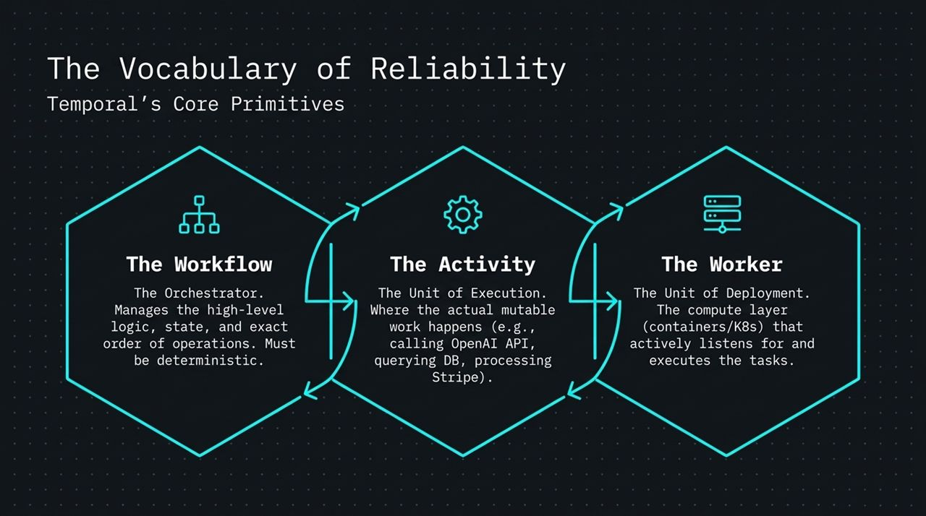
Notes:
To build agents on Temporal, you need to understand three key core primitives:
The Workflow (The Orchestrator):
The high-level function that orchestrates the overall logical sequence, state, and order of operations.
Golden Rule: Workflows must be strictly deterministic! They define the control flow (e.g., 'Do step A, then step B in parallel, then wait for human approval').
2. The Activity (The Unit of Execution):
Where the actual non-deterministic, mutable work happens.
This is where you place external API calls, database queries, Stripe payment executions, and calls to LLM providers (OpenAI, Anthropic, local models).
If an Activity fails—say, OpenAI returns a 503 service unavailable error—Temporal automatically retries the Activity based on your configured exponential backoff strategy without restarting the entire Workflow.
3. The Worker (The Unit of Deployment):
The compute layer (Docker containers, Kubernetes pods, VMs) hosting your code.
Workers poll the Temporal cluster for tasks, execute the Workflows and Activities, and report results back. You can easily scale workers up or down based on traffic load.
Once your workflow completes reliably, your code has survived. But that brings us to the next big question: What actually happened inside the model’s head while it was running?

Slide 7
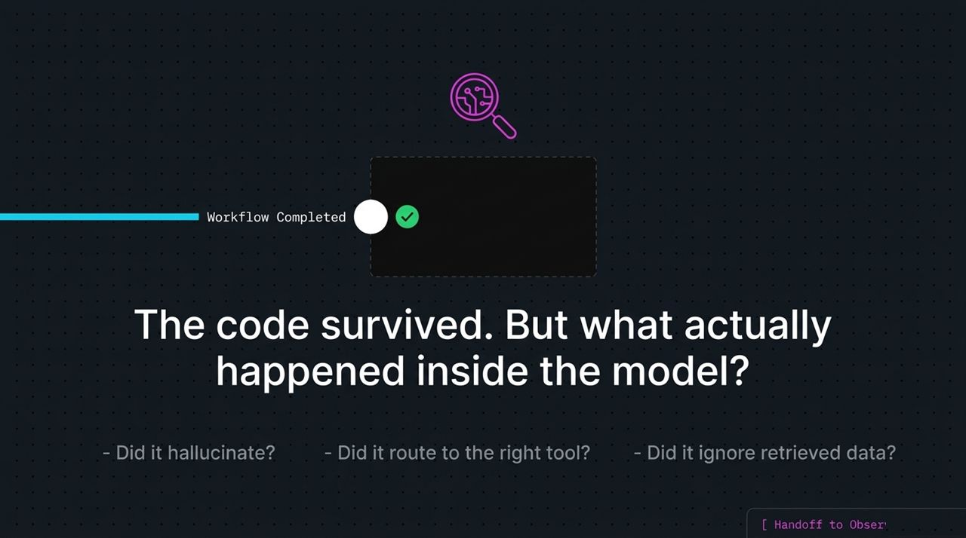
Notes:
Once Temporal guarantees execution, we hand off to Arize AI for observability. How do we open the 'black box' of an AI agent? Through Distributed Tracing.
Look at this trace waterfall diagram. A single agent interaction (agent.run_chat_session) took 3.2 seconds. Instead of viewing this as a single opaque block, distributed tracing breaks it down into individual Spans:
A tool_call: search_products span lasting 1.1s.
A child retrieval: fetch_catalog_data span lasting 400ms.
An llm.completion: gpt-4 span lasting 1.8s.
To standardize this telemetry across the industry, Arize leverages two open standards:
OpenTelemetry (OTel): The CNCF industry-standard protocol for moving distributed trace data across servers and services.
OpenInference: An open-source standard (donated to the CNCF by Arize) that injects AI-specific semantics onto standard OTel spans.
OpenInference explicitly tags generic spans as LLM calls, Tools, or Retrievals, capturing token counts, model parameters, system prompts, retrieved context, and latency per step.

Slide 8
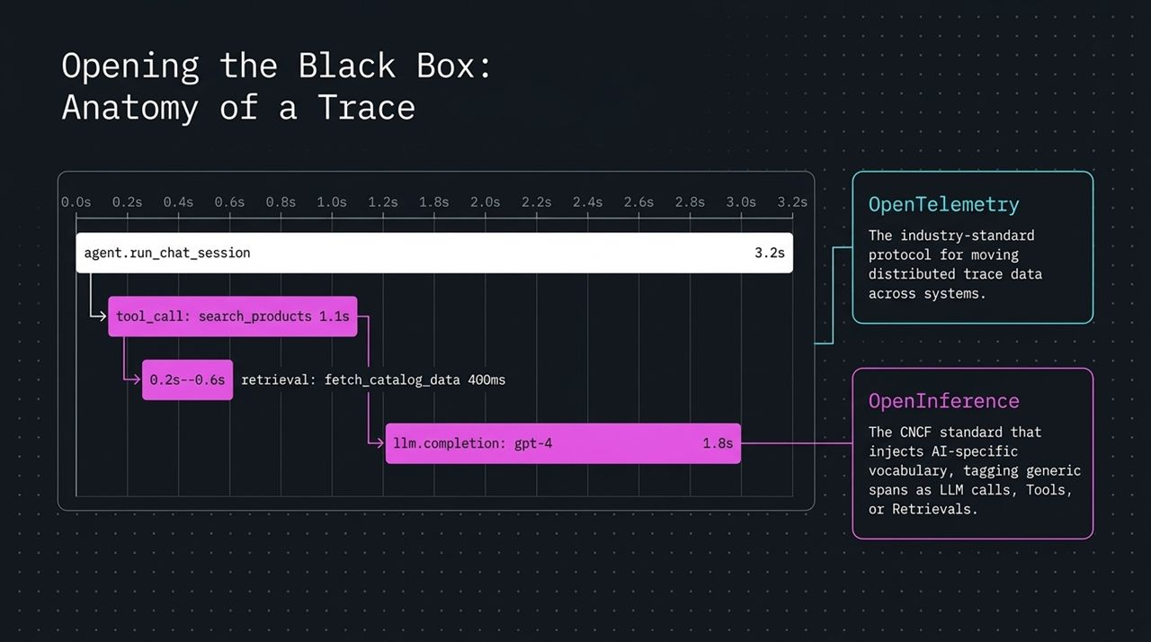
Notes:
Having traces is step one. But in production, you can't manually read thousands of trace waterfalls every day. You need automated quality checks. This is where LLM-as-a-Judge Evaluators come in.
In the demo and architecture shown on screen, we set up a Trace-Level Grounding Evaluator.
Look at the data flow:
Retrieved Tool Data: The database tool returned { id: 101, name: Velvet Paws Bear, price: 32 }.
Agent Output: The model generated: 'I recommend the Velvet Paws Bear for your gift.'
The Grounding Evaluator: An automated evaluator inspects both the tool output and the final agent output. It verifies whether product names, prices, and IDs in the response are explicitly grounded in the tool context.
If all facts match, it receives a score of [1] GROUNDED. If the agent invented a product name or price not returned by the tool, it receives a score of [0] HALLUCINATED.
Crucially, as discussed in the webinar, evaluators themselves are validated against human-labeled ground truth to ensure the rubric remains accurate and aligned.

Slide 9
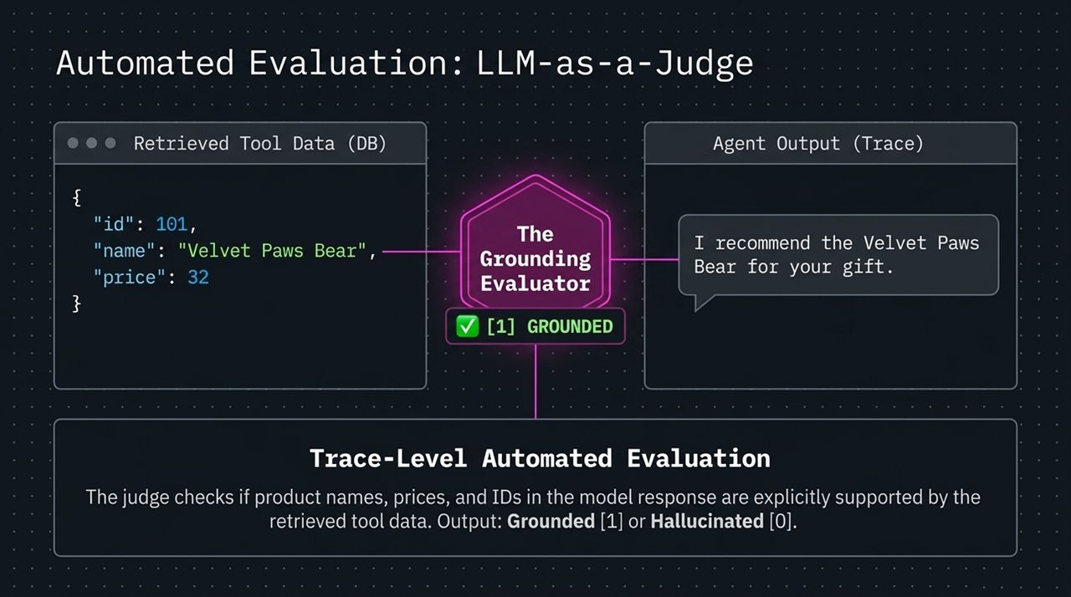
Notes:
In real-world enterprise applications, agents frequently require human authorization before executing high-value operations—like approving a $1,000 purchase or sending an external email.
How do we architect Human-in-the-Loop efficiently?
In Temporal, we utilize the Entity Pattern and Signals/Updates:
The Agent Loop runs its initial reasoning and reaches a checkpoint: Wait_For_Human_Approval.
The Temporal Workflow pauses and enters a suspended state. No compute resources, CPU cycles, or server threads are wasted while waiting. It can wait 5 minutes, 5 hours, or 5 days.
When a human clicks 'Approve Purchase' in the UI, a Temporal Signal/Update injects the authorization payload directly into the workflow’s persistent state.
The agent instantly resumes execution and triggers the Purchase Tool.
Meanwhile, Arize captures this entire paused-and-resumed interaction under a Unified Session Trace. This maintains full context across multi-turn human-agent sessions, letting you inspect the exact timeline of human intervention.

Slide 10
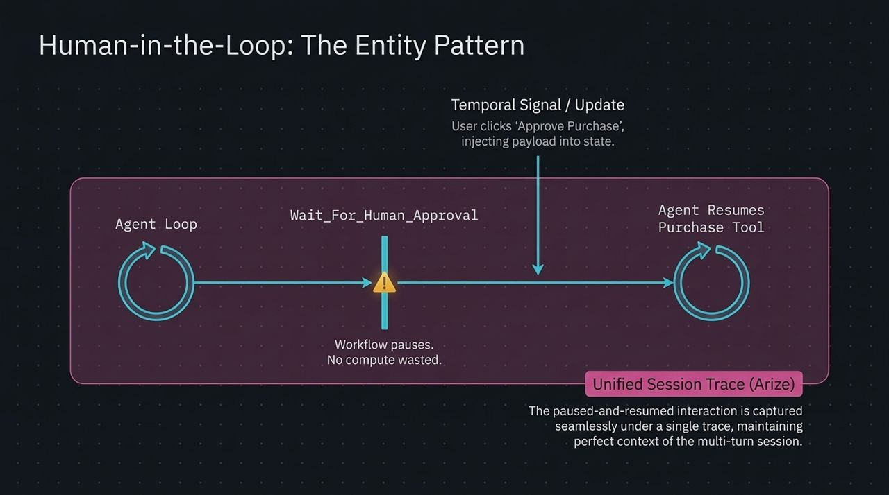
Notes:
Now, let’s look at how we close the loop from observing failures to actively fixing them. Arize introduces an autonomous mechanism called The Signal Agent.
Here is the automated self-healing workflow:
Trace Collection: Telemetry and trace data flow continuously from Temporal workers into Arize.
Background Scan: The Signal Agent runs scheduled scans across recent trace logs.
Pattern Detection: Rather than alerting you on isolated glitches, the Signal Agent detects systemic clusters. For instance: 'Multiple traces show LLM fabricating products not returned by database tool calls.'
Autonomous Action: The Signal Agent generates an actionable solution. It opens a Pull Request (PR) in your repository with suggested prompt or logic fixes (e.g., strengthening prompt system instructions to strictly cite retrieved items).
Golden Dataset Curation: Simultaneously, it extracts those flagged failure traces to compile a Golden Dataset for regression testing before you deploy the new release.

Slide 11
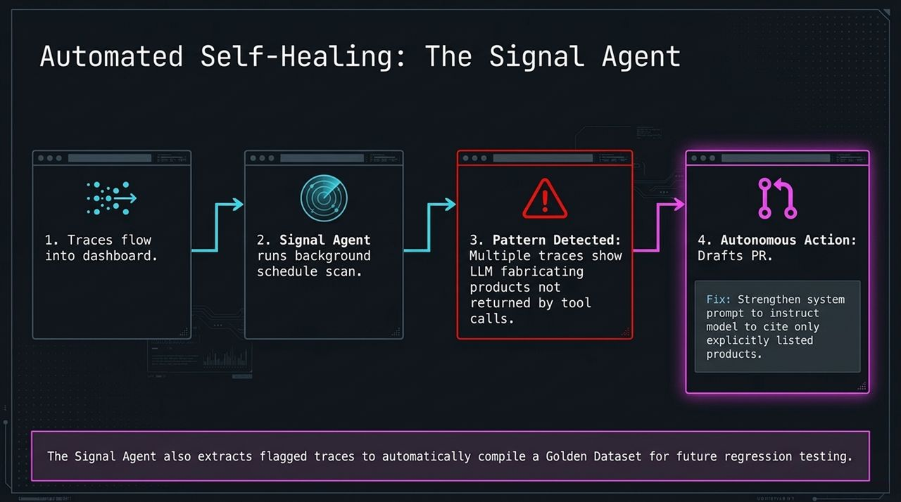
Notes:
Here is the complete Unified Reference Architecture based on the e-commerce shopping assistant demo.
Let's trace a user request from end to end:
User Interface: The user asks the Next.js Chatbot Frontend: 'Buy a Teddy Bear.'
Execution Layer (Temporal): The frontend issues an execution request to Temporal Workers running long-lived agent workflows.
External & Internal Services: The Temporal workflow coordinates calls out to OpenAI for reasoning, queries the Internal DB (Product Catalog) via hybrid semantic/keyword search, and processes payments securely via Stripe.
Telemetry Layer (Arize AI): Every single action, tool call, model prompt, and response emits OpenInference traces directly into Arize AI.
Quality Control: Arize runs the Grounding Evaluator to ensure the product recommended to the user matches actual database records.
This architecture completely decouples durable execution management from AI quality observability, giving enterprise applications both resilience and precision.

Slide 12
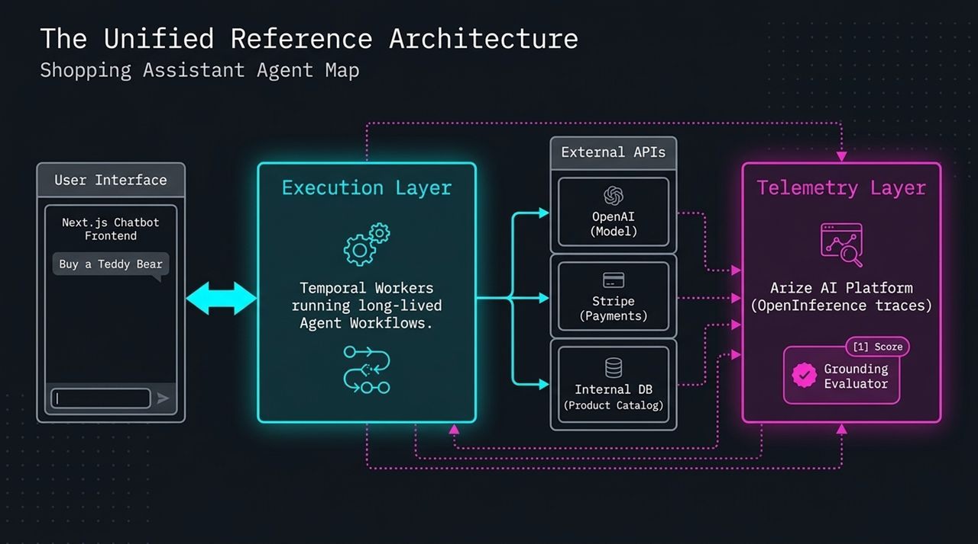
Notes:
To maintain high-performing AI agents over time, development teams must operate within a Continuous Improvement Loop:
Phase 0: The Black Box: This is where teams start—blind deployment with zero visibility into internal reasoning or tool selection.
Phase 1: Instrument: You add OpenTelemetry and OpenInference to your Temporal agent workflows.
Phase 2: Observe: You explore trace waterfalls, track latency/cost breakdowns, and analyze multi-turn conversation sessions in Arize.
Phase 3: Evaluate: You apply Grounding Evaluators and LLM-as-a-Judge scoring to continuously measure response quality against business rules.
Phase 4: Improve: You leverage the Signal Agent to detect recurring failure modes, automatically build Golden Datasets, and push PR fixes.
Core Principle: Prototypes are designed to act. Production agents must be engineered to survive and learn.

Slide 13
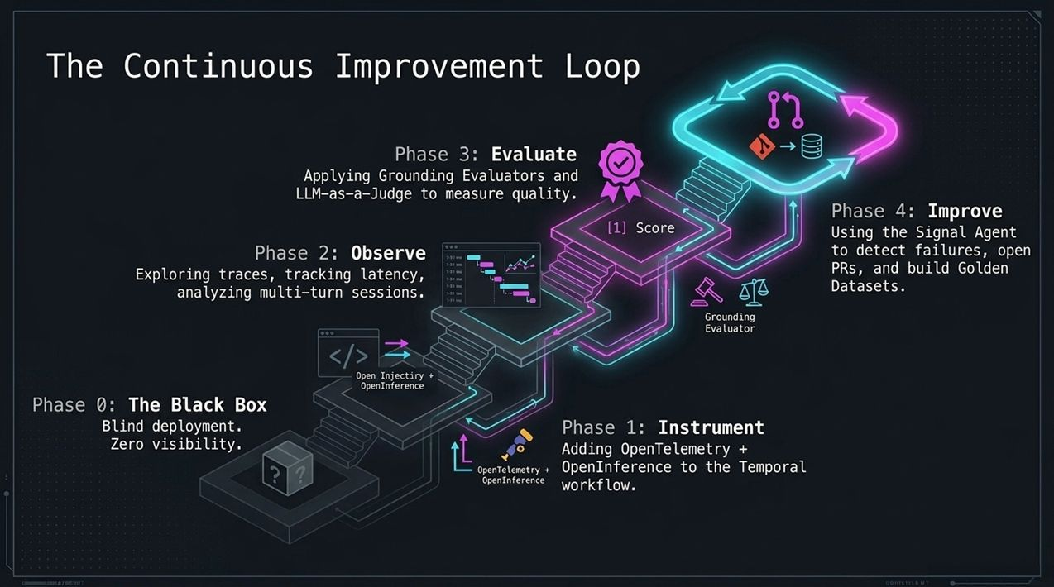
Notes:
In this deep-dive slide, let's examine how infrastructure isolation protects your agent applications.
Notice the shielded server diagram. When building enterprise agents, you must separate your application compute layer from your state persistence layer.
By running agent logic inside worker containers while offloading state management to Temporal's persistence cluster, your application gains complete crash immunity. Even if an entire cloud availability zone goes dark, another worker pool picks up the workflow state intact.
At the same time, telemetry spans are exported out-of-band via OpenTelemetry gRPC exporters, ensuring that logging and tracing overhead never slows down worker performance or introduces execution latency for the end user.

Slide 14
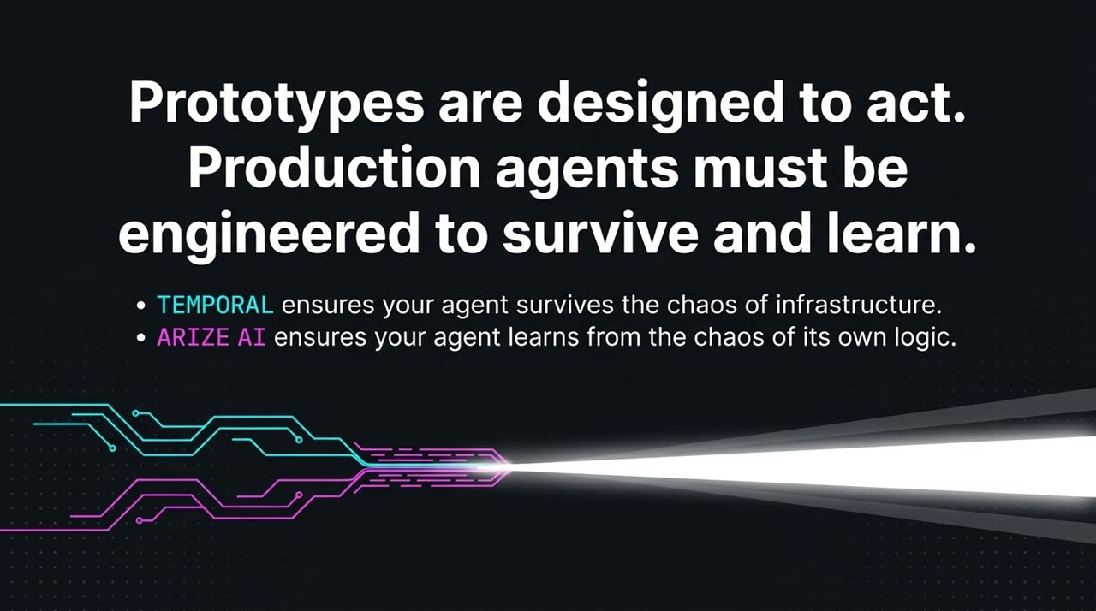
Notes:
Let's zoom into the internal decision nodes of an agent run.
When an LLM executes a reasoning step, it evaluates multiple branches: Should it trigger a Tool Call, stay in the Model Loop, or finalize the Reasoning Step?
Without detailed tracing, if a model takes 10 seconds to respond, you have no way of knowing whether the bottleneck was slow database retrieval, an inefficient prompt, or an endless tool call loop.
With OpenInference tagging, every step—from initial intent detection to payload formatting and tool dispatch—is captured with precision latency measurements. This allows engineers to pinpoint exactly where performance degrades or where reasoning breaks down.

Slide 15
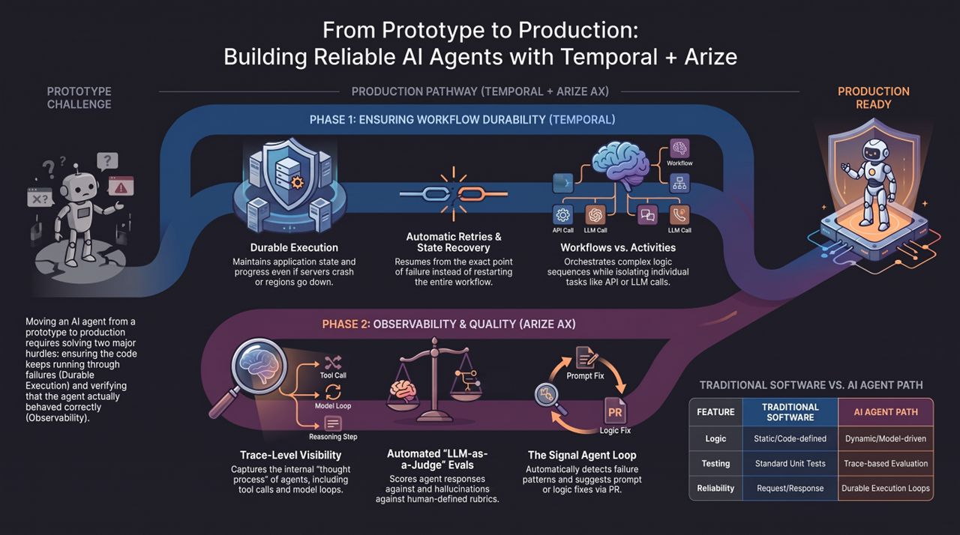
Notes:
To summarize everything we’ve covered today, let's look at the Comparison Matrix and your Production Pathway.
Traditional Software vs. AI Agent Path:
Logic: Traditional software relies on static/code-defined logic. Agents rely on dynamic/model-driven reasoning.
Testing: Traditional software uses standard unit tests. Agents require trace-based evaluation and LLM-as-a-Judge rubrics.
Reliability: Traditional software uses simple request/response retries. Agents require durable execution loops.
Your 2-Phase Production Pathway:
Phase 1: Ensure Workflow Durability (Temporal): Wrap your agent tasks in Workflows and Activities. Enable automatic retries, state recovery, and crash survival.
Phase 2: Establish Observability & Quality (Arize AX): Instrument your code with OpenTelemetry and OpenInference. Implement automated evaluators for grounding and hallucinations, and enable the Signal Agent to drive continuous self-healing via PRs.
Final Closing Thought:
Temporal ensures your agent survives the chaos of infrastructure.
Arize AI ensures your agent learns from the chaos of its own logic.
Thank you! We'll now open the floor to Q&A.
How to Build Reliable Long-Running AI Agents | Temporal + Arize
https://www.youtube.com/watch?v=TAXglqzS7F0

